Slide 1
Battle of Neighbourhoods
Coursera Capstone

Slide 2
Introduction
The purpose of this capstone project is to help people finding better facilities in and around their neighbourhood. It will help people in taking smart decision on selecting better neighbourhood in Scarborough, Toronto. The project aims to create an analysis of features for a people migrating to Scarborough to search a great neighbourhood as a comparative analysis between neighbourhoods. The features include house price, better school, low crime rates, good road connectivity and weather conditions, good services in case of emergencies, fresh water resources, etc. This project will help people to get awareness of the area and neighbourhood before moving to a new city, state, country or place for their work or to start a new fresh life.

Slide 3
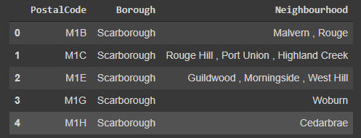
Data
Data Link: https://en.wikipedia.org/wiki/List_of_postal_codes_of_Canada:_M
We will use Scarborough dataset from week 3. This dataset consists of latitude and longitude and zip codes.
Cleaned data:

Slide 4
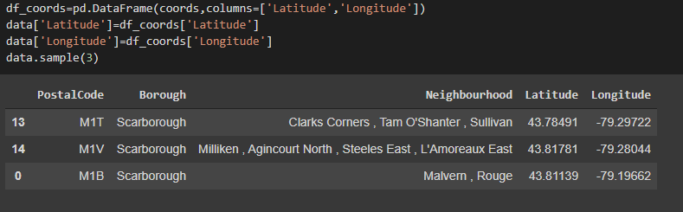
Adding Latitude and Longitude to the data

Slide 5
Foursquare API
We will also need data about different venues in different neighbours of that specific borough. In order to that information, we will use Foursquare location information. Foursquare is a location data provider with information about all manner of venues and events within an area of interest. Such information includes venue names, locations, menus, and even photos. As such, the foursquare location platform will be used as the sole data source since all the stated required information can be obtained through the API. After finding the list of neighbourhoods, we then connect to the Foursquare API to gather information about venues inside each and every neighbourhood. For each neighbourhood, we have chosen the radius to be 500 meters and the number of venues to be explored as 100. The data retrieved from Foursquare contained information of venues within a specified distance of the longitude and latitude of the postcodes.

Slide 6
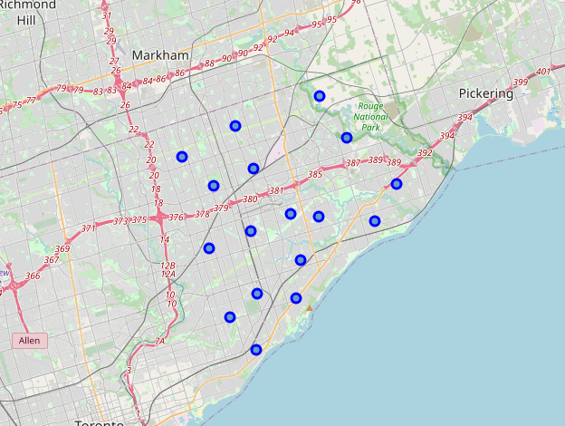
Map of Scarborough

Slide 7
Clustering Approach:
To compare the similarities of two cities, we decided to explore neighbourhoods, segment them, and group them into clusters to find similar neighbourhoods in a big city like New York and Toronto. To be able to do that, we need to cluster data which is a form of unsupervised machine learning: k-means clustering algorithm.
Work Flow:
Using credentials of Foursquare API features of near-by places of the neighbourhoods would be mined. Due to http request limitations the number of places per neighbourhood parameter would reasonably be set to 100 and the radius parameter would be set to 1000.

Slide 8
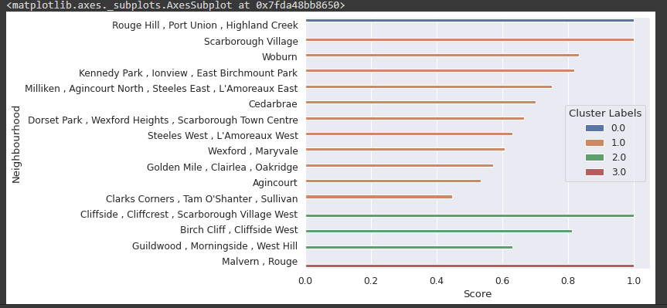
Comparing the neighbourhoods

Slide 9
Conclusion
In this project, using k-means cluster algorithm I separated the neighbourhood into 3 different clusters. This dataset has very-similar neighbourhoods around them. I also get the scores of the neighbourhoods from the scores of the venues in the neighbourhoods and sorted them in their descending order. I feel rewarded with the efforts and believe this course with all the topics covered is well worthy of appreciation. This project has shown me a practical application to resolve a real situation that has impacting personal and financial impact using Data Science tools. The mapping with Folium is a very powerful technique to consolidate information and make the analysis and decision better with confidence.

Slide 10
Future work
This project can be continued for making it more precise in terms to find best house in Scarborough. Best means on the basis of all required things (daily needs or things we need to live a better life) around and also in terms of cost effective.

